Slide 1
AdoptAPet
WebSite
Team4u
08 May 2020

Slide 2


Agenda
Team
Overview
Business Case
Goal
Scope
Roles and Responsibilities
Technical Specification
Live Presentation

Slide 3
Team4u
Neelima Pallanti
Andrés Sanz Buezo
Ilia Mazourine
Oleg Szytmaniuk

Slide 4
Overview
There are many homeless cats and dogs around that deserve to have a home. The idea is to support polish foundation “A Place Good For Animals” by building up WebSite. This should help find a new home for our furry friends.

Slide 5
Business Case Benefits
Number of adopted pets increase by 25% (animals might be adopted beyond Poland)
Means to help animals to be increased by 25%
Tracking all pets owners
Numbers of volunteers to be increased by 15%

Slide 6
Goals
Handling online requests for Pets Adoption.
Displaying all pets available for adoption
Donation availability.
Volunteers involvement.

Slide 7
Scope
Feature for the Pet Adoption -> FORM to fill in
Feature for Donation
Feature for Volunteers to get involved to help pets
Feature to show Available Pets.
Feature for Admin -> CRUD.
Search a pet (dog/cat).

Slide 8
Roles and Responsibilities
Name | Responsibilities
Neelima | Nav / Footer / Volunteers
Andrés | DB design / Pets Adoption
Ilia | Donation - Paypal / Stripe
Oleg | Home / About Us / Contact Us / Personal Area

Slide 9
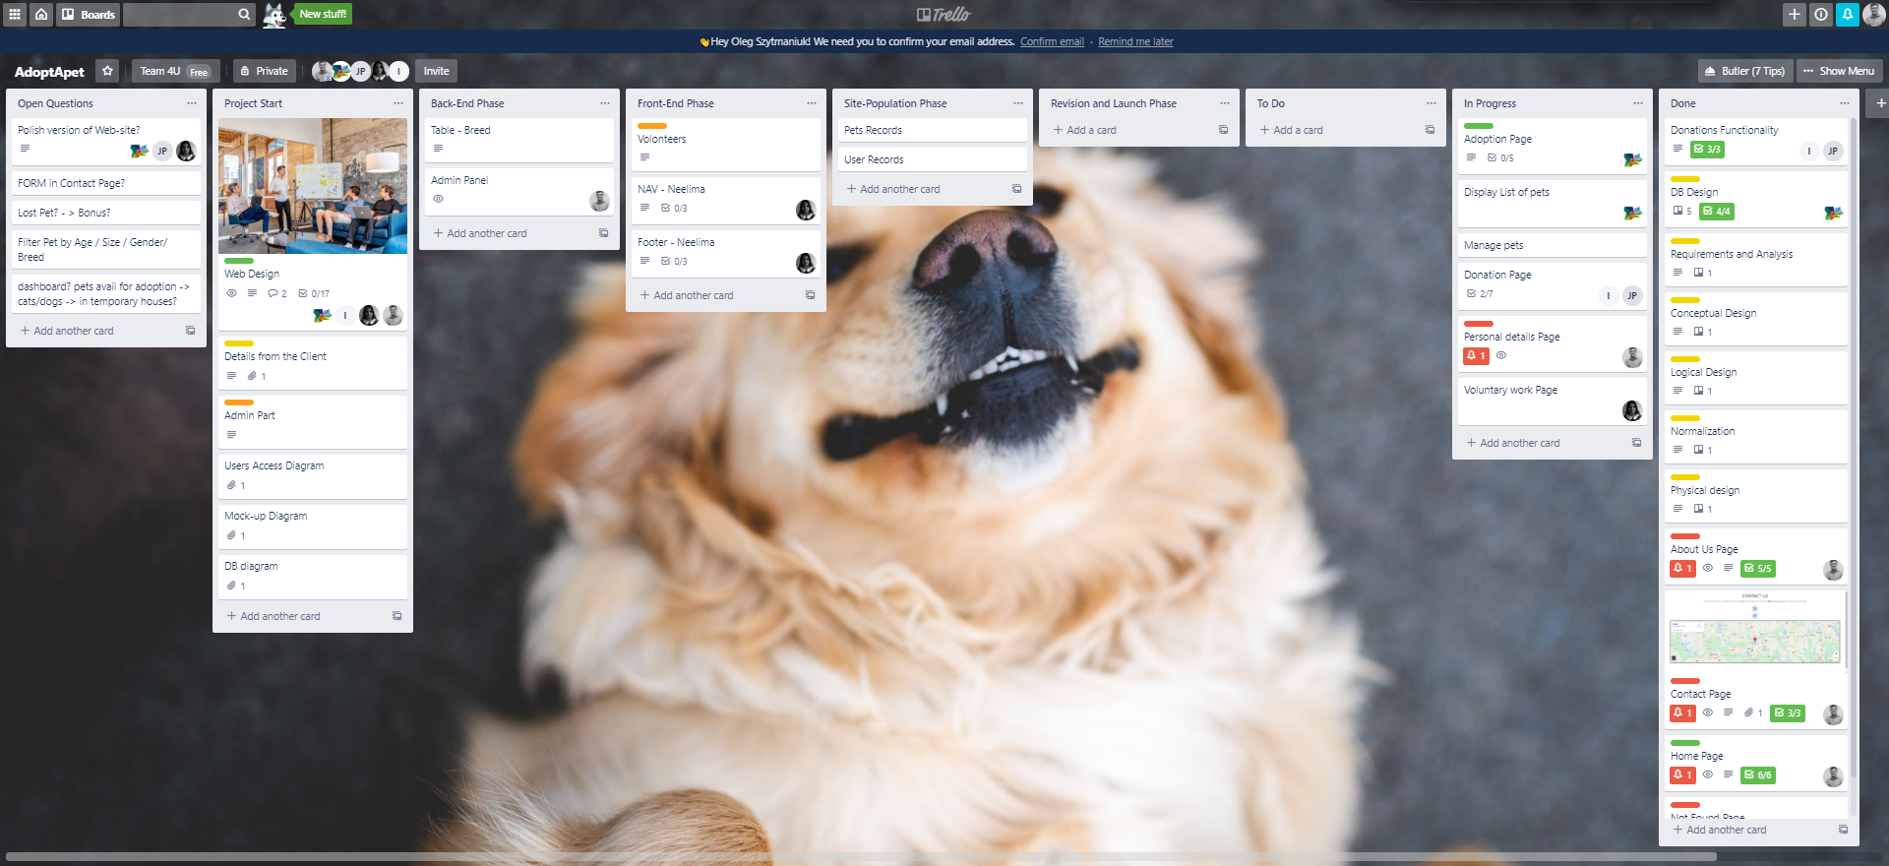
Technical Specification
Trello - Project Management
GitHub - Soft Dev tool
VS Code - source-code editor
DISCORD - Team Communication tool
DB host provider - www.freemysqlhosting.net
WebSite Hosting - HEROKU

Slide 10
Technology Used
Laravel PHP Framework
HTML 5
CSS 3 / SASS
Vanilla JS
jQuery
Stripe Implementation
Bootstrap
MVC

Slide 11
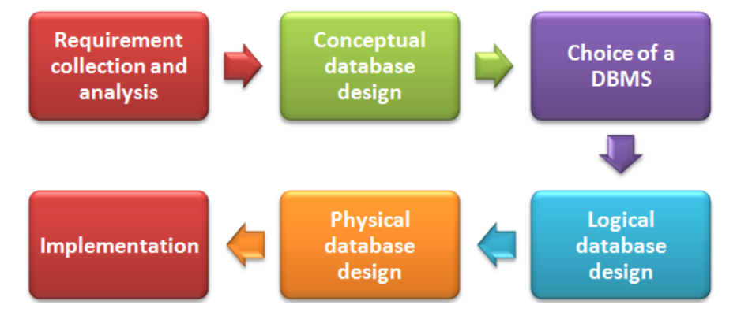
DB Design
A well-structured database:
Saves disk space by eliminating redundant data.
Maintains data accuracy and integrity.
Provides access to the data in useful ways.

Slide 12
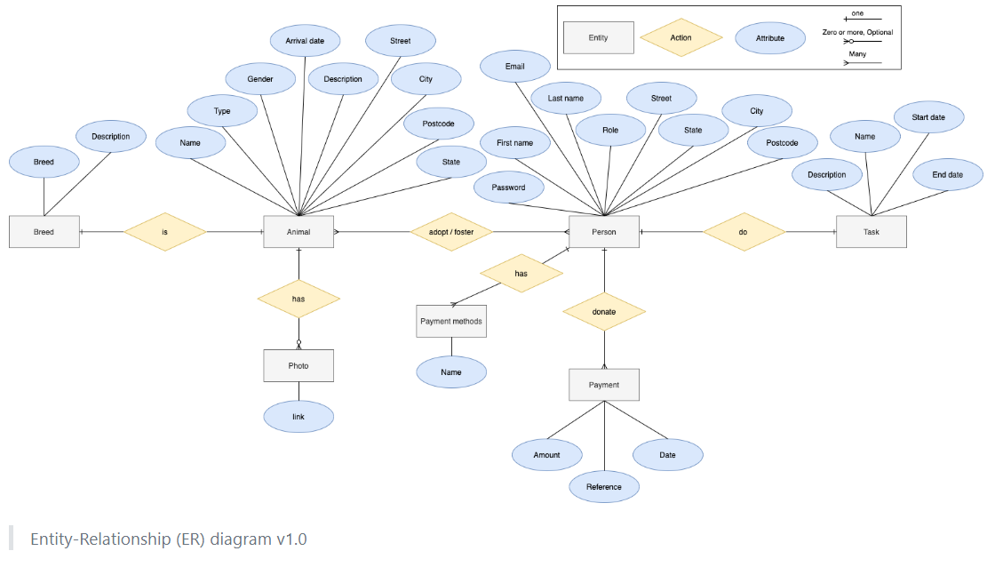
Entity Relationship Diagram

Slide 13
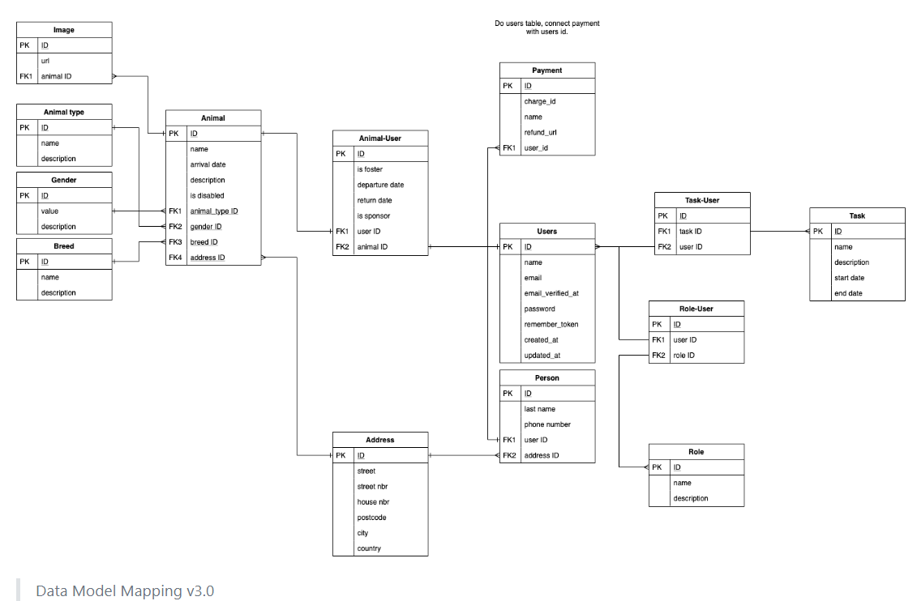
Logical Design

Slide 14
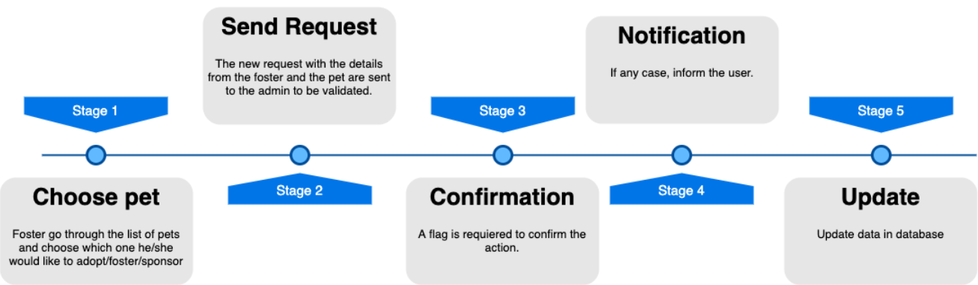
PET Adoption Workflow

Slide 15
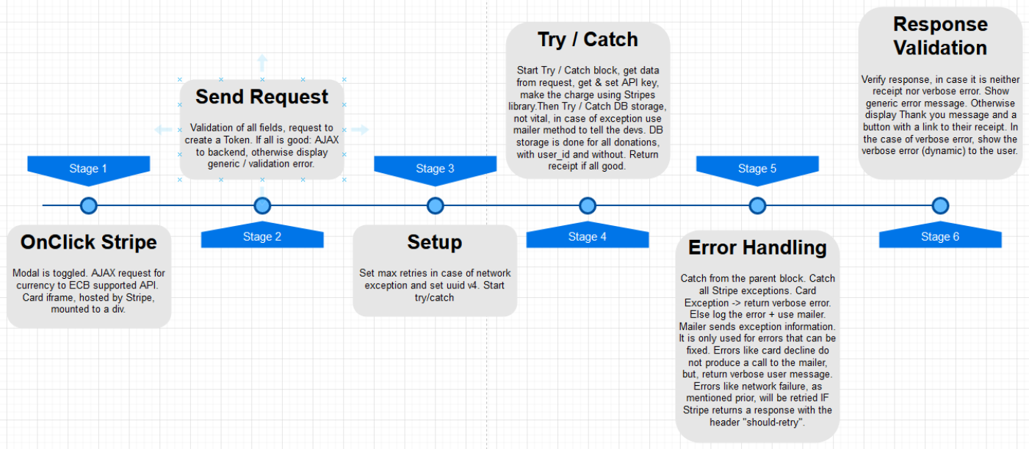
STRIPE Overflow

Slide 16
Difficulties Encountered
To have a common agreement on styling
Coding alignment expectation (to keep code neat and clean)
Code Versioning on GitHub -> resolving code conflicts
Learning how to implement features never used before - STRIPE / HEROKU

Slide 17
Live Project Demonstration

